Slide 1




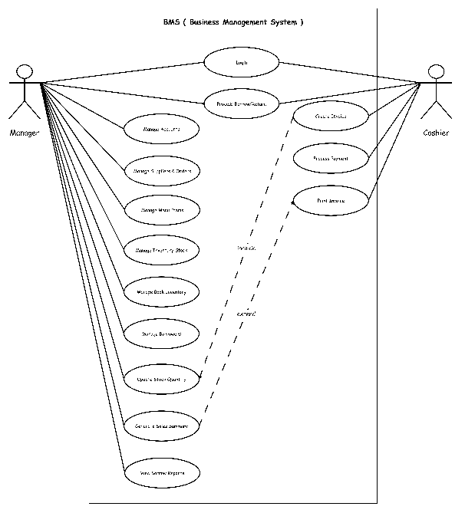

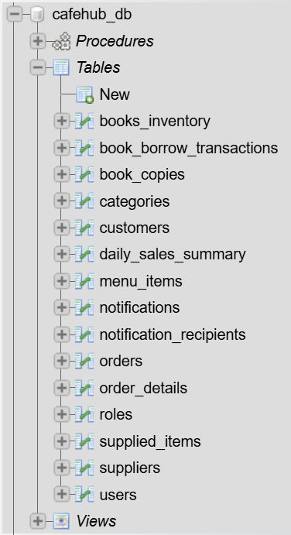
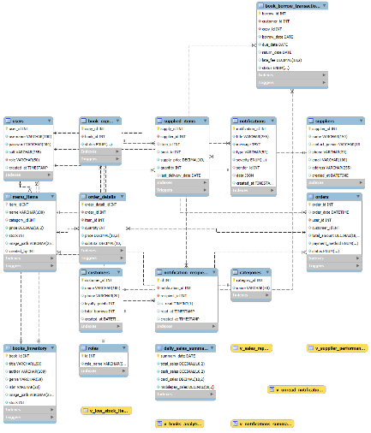
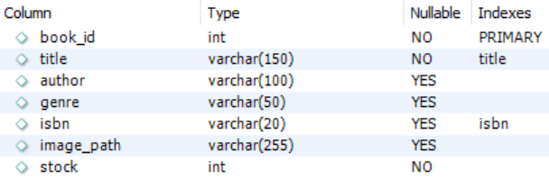

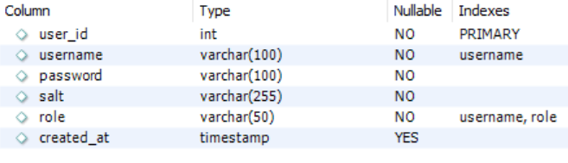
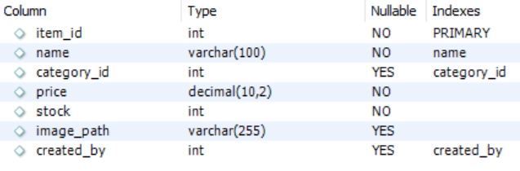
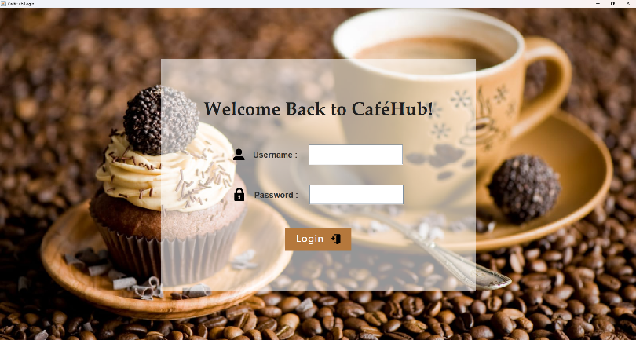
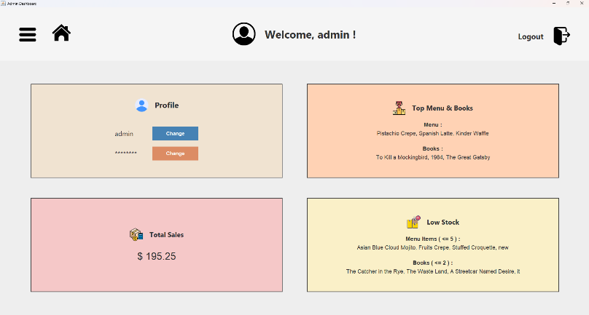

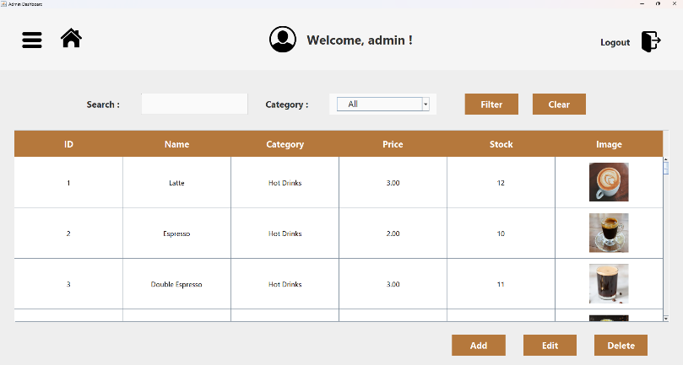
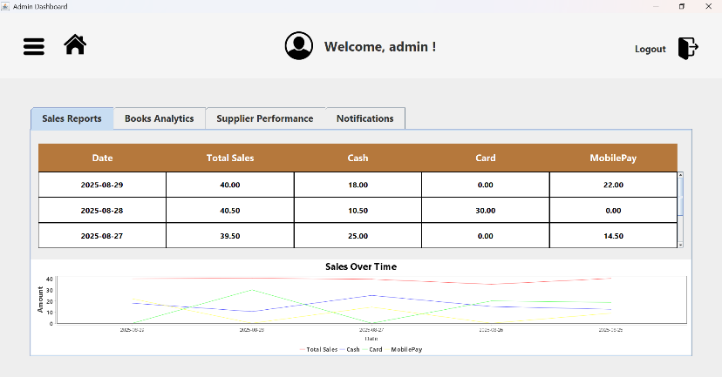

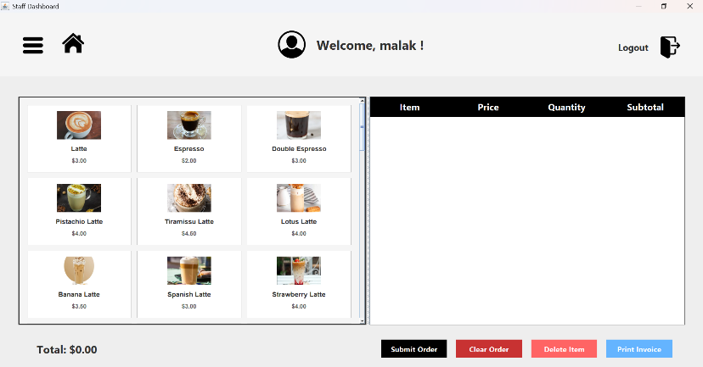
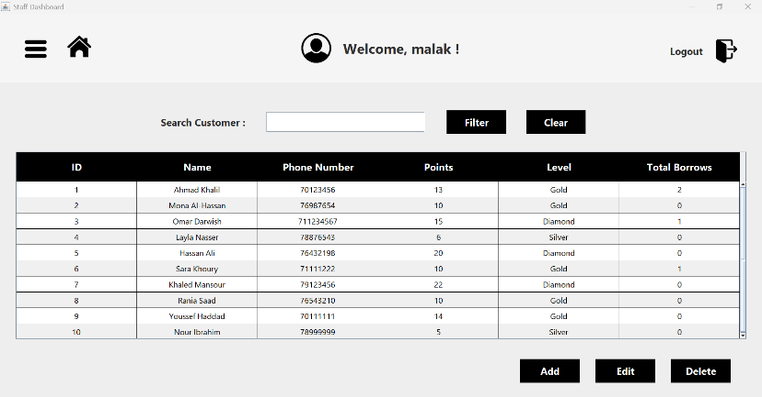
Coffee Shop Management System
Summer Project
By: Nour Mrad & Malak Yazbek
Supervised By : Dr. Mohammad Choker
ABSTRACT
Main Tasks
Aim :
To develop an efficient and user-friendly coffee shop management system that automates and simplifies operations.
Objectives :
Replace outdated paper or Excel methods with user-friendly, digital systems.
Technologies :
Java (Swing for GUI), MySQL for Database Management, NetBeans IDE.
🔑 Admin Functions
  User Management : Manage users and assign roles.
  Menu Management : Add, edit, and update menu items.
  Books Inventory : Track available books and borrowing records.
  Supplier Management : Record suppliers and deliveries.
  Reports & Analytics : Generate sales, inventory, and customer reports.
  👨‍💼 Staff (Cashier) Functions
  Create Order : Process dine-in, takeaway, or delivery orders.
  Customer Service : Register/update customer details and feedback.
  Book Borrowing : Manage borrowing and returning of books.
  Alerts Handling : Receive low stock, delivery, or overdue alerts.
SYSTEM OVERVIEW
Graphical Interface (GUI) :
Simple and user-friendly screens for both Admin (management) and Staff (cashier).
Admin Features :
Manage users, menu, books inventory, suppliers, and generate reports.
Staff Features :
Create orders, handle customer service, manage borrowing, and respond to alerts.
Database Integration :
Uses MySQL for secure, reliable, and fast data storage, ensuring consistency across all operations.
DATABASE STRUCTURE
📋 Tables ( 15 total ) :
roles
users
customers
categories
menu_items
orders
order_details
books_inventory
book_copies
book_borrow_transactions
suppliers
supplied_items
daily_sales_summary
notifications
notification_recipients
SOFTWARE IMPLEMENTATION
BENEFITS
Offline & Fast : Runs without internet with quick performance.
Secure & Reliable : Local storage ensures data consistency.
Customizable : Fits both café and book inventory needs.
Cost-Effective : No subscription, one-time installation.
Full Control : Café owns system and data fully.
CONCLUSION
The CaféHub Management System offers a secure and efficient way to manage café operations. With Java Swing and MySQL, it ensures fast, offline, and reliable performance. It reduces manual errors and improves productivity, making daily operations smoother and more effective.

